Slide 1
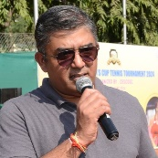
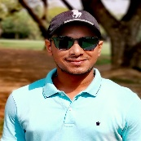
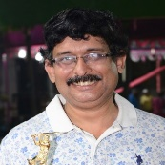
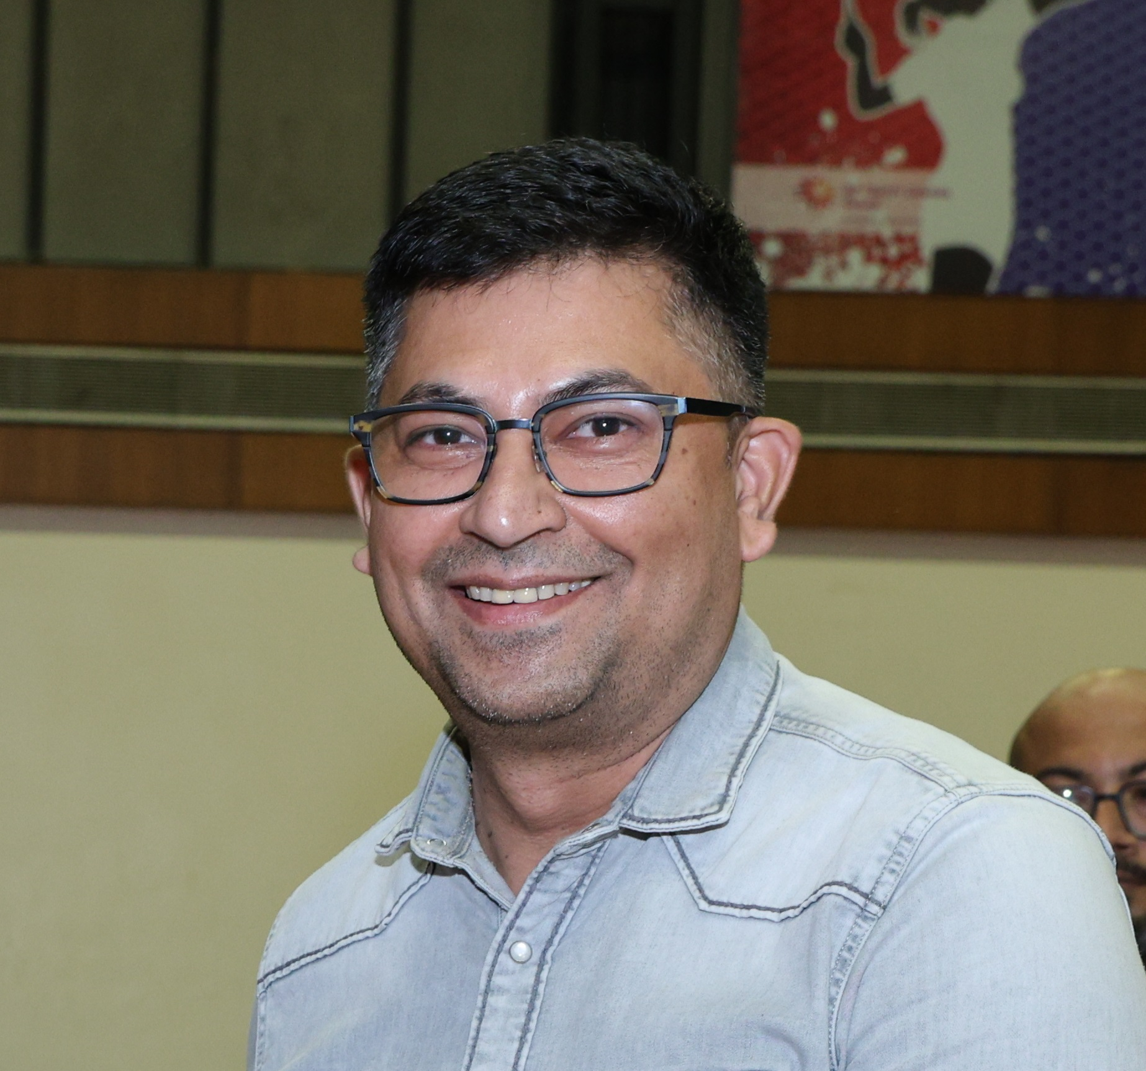
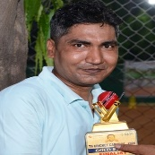
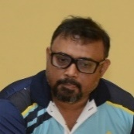
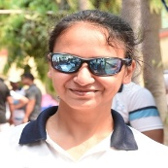
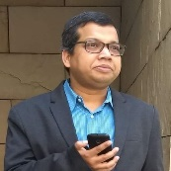

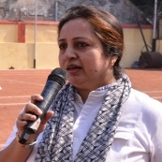
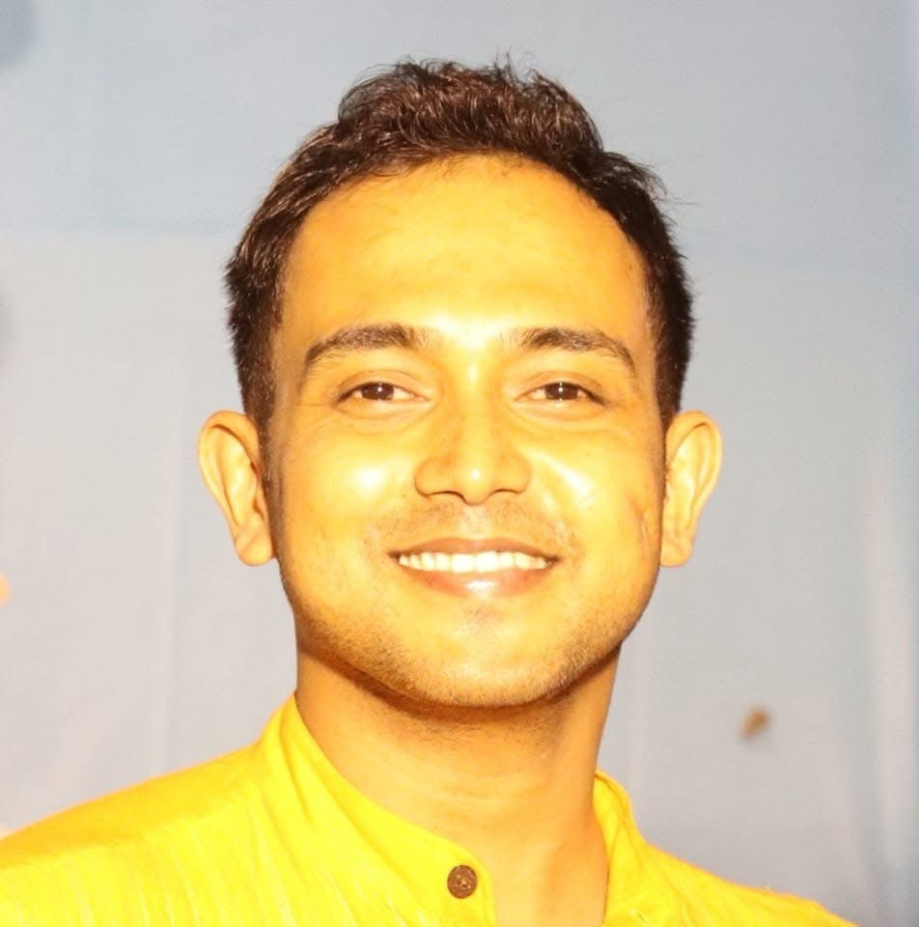
Executive Committee - CESCOSC
Mr. Kapil Thapar
President
Mr. Snehasis Samaddar
Vice President
Mr. Vernon Morais
Vice President
Mr. Subir Verma
Chief Patron
Mr. Bratin Ghosh
Mentor
Treasury
Kaushik Banerjee, Treasury Secretary
  Pradipta Hati
  Tanmoy Mishra
Tennis
  Sampad Ghosh, Tennis Secretary
    Sangram Singha
    Debmalya Datta
Football
  Suvro Banerjee, Football Secretary
    Soumik Nag Roy
    Avik Mallick
Branding & Talent Management
  Amit Das, BTM Secretary
  Arijit Mitra
Cricket
  Majidur Islam, Cricket Secretary
  Sourav Gupta
  Arnab Choudhury
Table Tennis
  Ramkrishna Saha, TT Secretary
    Sujay Podder
    Biswajit Saha
Communication
Roshni Guhathakurta, Comm. Secretary
  Tathagata Roy Choudhury
  Puskar Basu
Cultural
  Anindya Sen, Cultural Secretary
    Nilanjan Daripa
    Eshita Roy
Badminton
  Soumyajit Konar, Badm. Secretary
    Sakya Singha Maity
    Swagata Banerjee
Athletics
  Roshni Guhathakurta, Ath. Secretary
    Sourya Banerjee
Feedback & Grievance Redressal
  Rajrupa Majumder, FGR Secretary
    Sujay Sahu
Suhash Chakraborty , General Secretary

